Slide 1
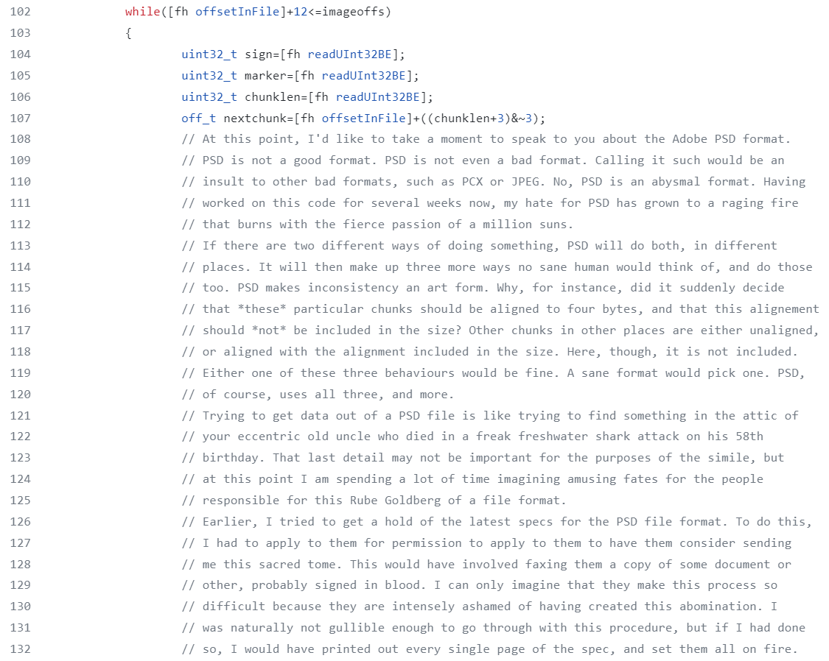
Notes:
Making stuff is hard. Like, really, really hard.

Slide 2
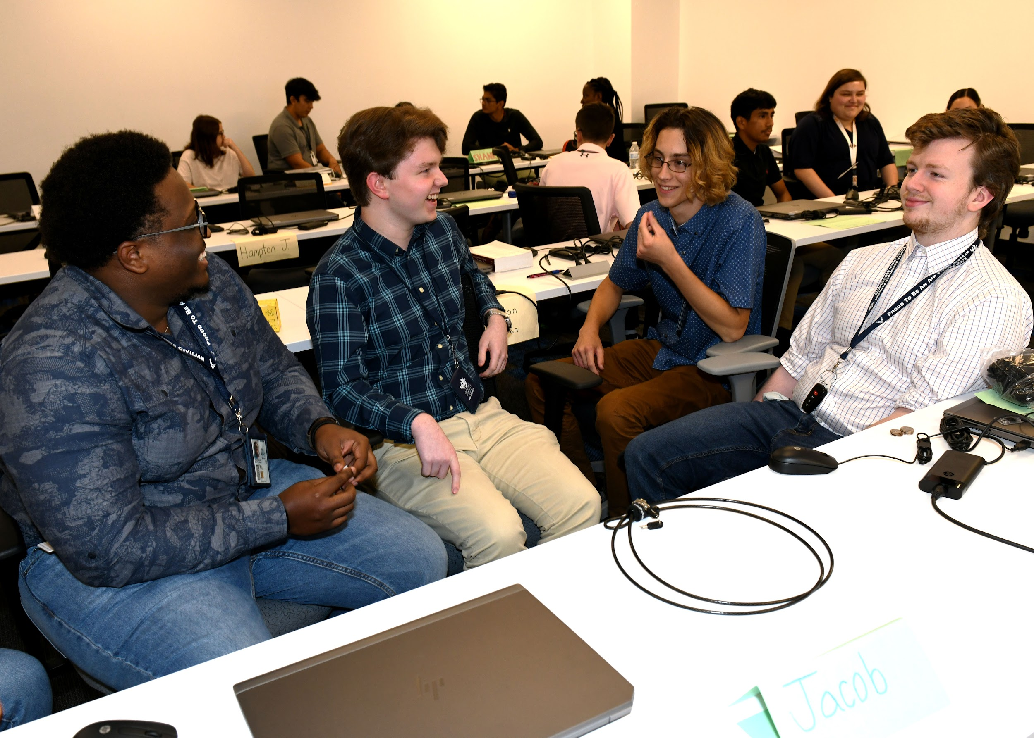
Notes:
When we want to embark on a big project, we need a team to make it happen.

Slide 3

Notes:
There’s just one problem: how do we effectively communicate our ideas?

Slide 4
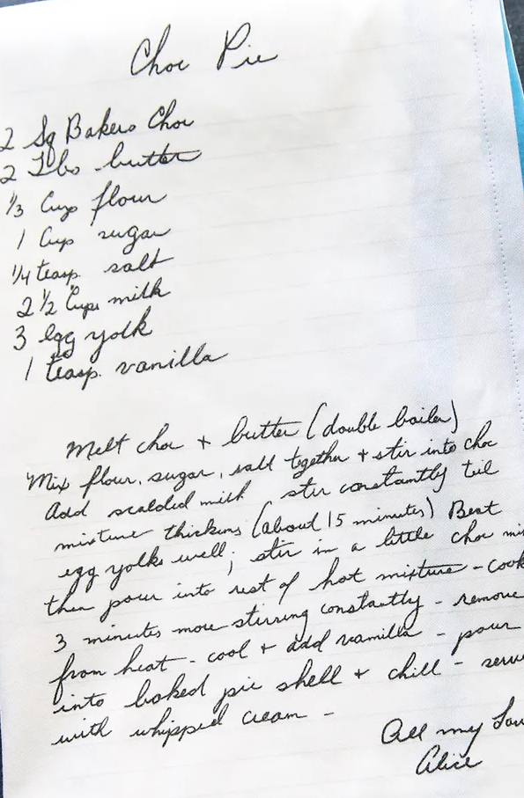
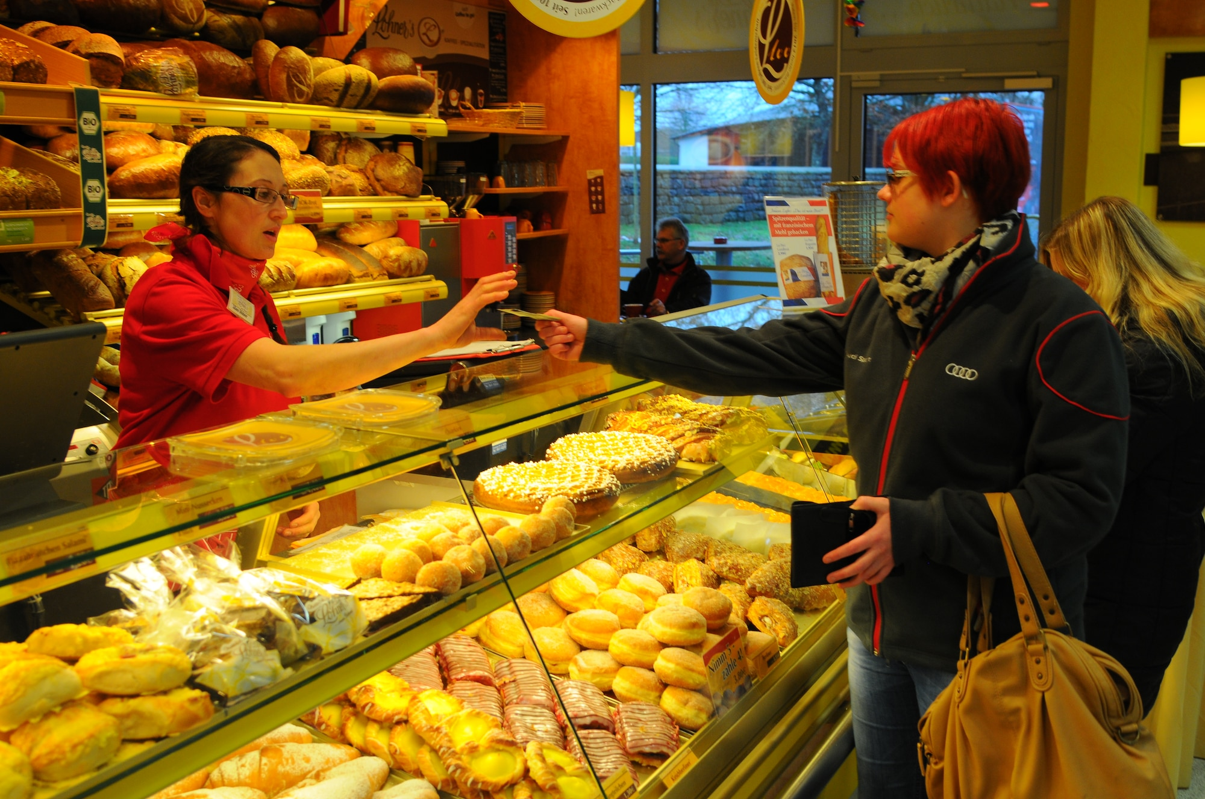
Notes:
when a baker and a client are communicating about how a cake is to be made, the baker may create an interim recipe that they and the client can evaluate

Slide 5
Hello, I’m looking for a chocolate cake for a friend’s birthday. It’s got to be gluten-free.
No problem!
User Requirements
Notes:
first, a client tells the baker what they need from the cake—3 tiers, chocolate, strawberry frosting, gluten-free—and lets the baker sweat the small stuff (user requirements)

Slide 6
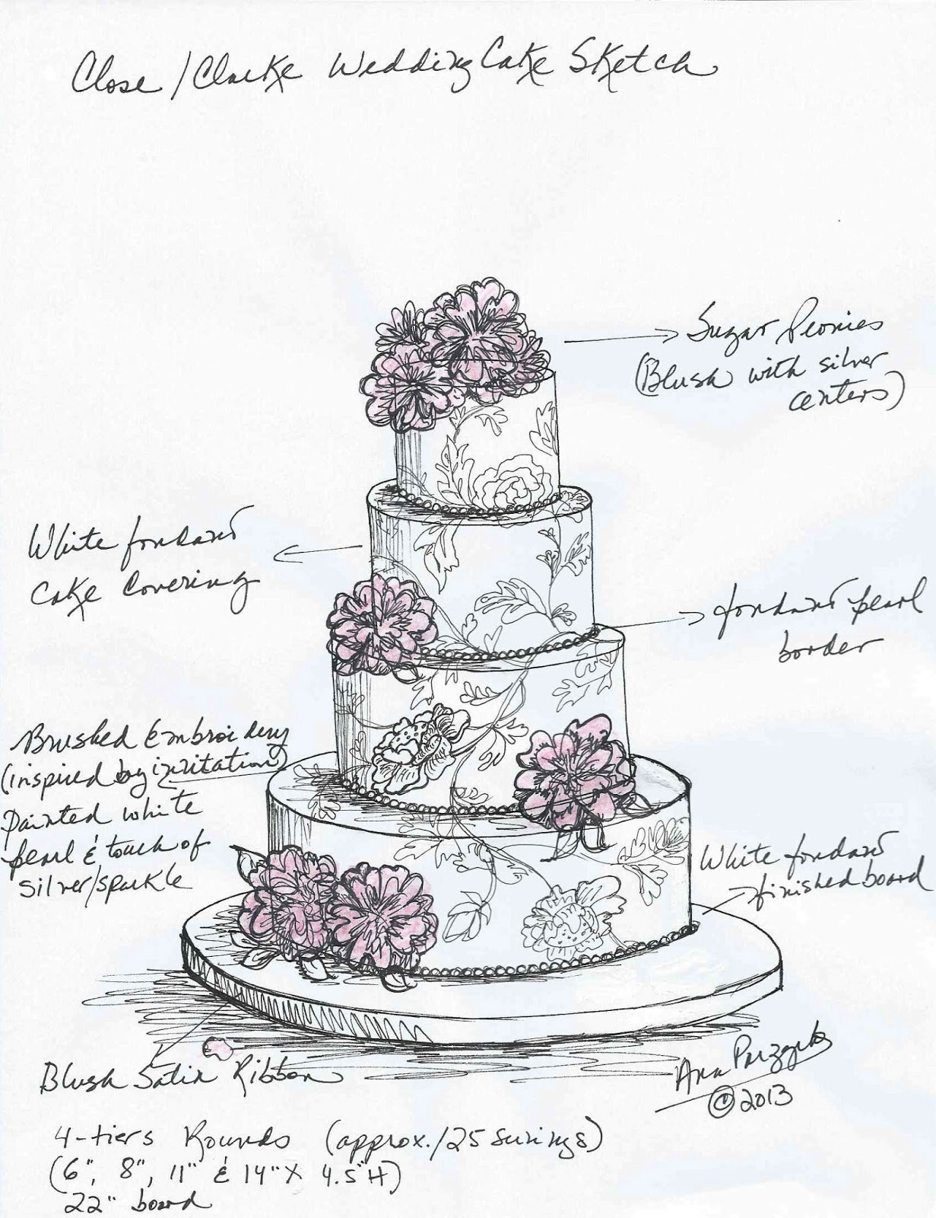
Time to figure this out!
Specification
Notes:
the baker with those requirements designs a cake, drawing out its shape, creating a list of ingredients, and writing up decoration instructions (specification)

Slide 7
Does this look good?
The cake looks beautiful(!), but I just learned that a vegan friend is coming to the party…
No problem! Let me quickly edit the recipe.
Validation
Notes:
the baker then shares their specification with the client, making sure that the users’ requirements are met; for example, the baker may realize they didn’t set enough ingredients aside for the user’s desired serving size, or the client may realize that they actually need the cake to be vegan, even though they didn’t initially mention it (validation)

Slide 8
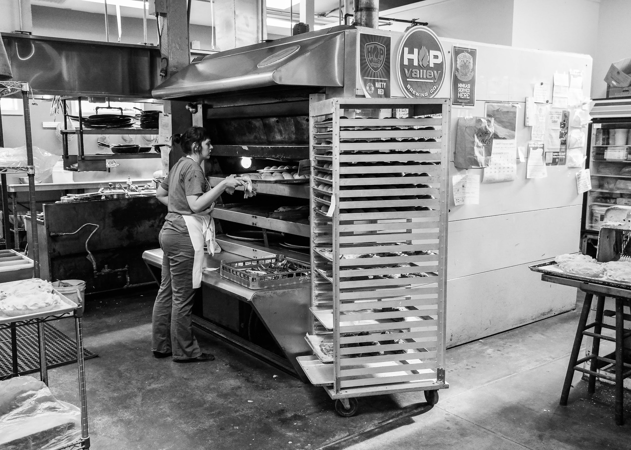
Let’s get to baking!
Implementation
Notes:
the baker then uses their specification, now revised and validated, to actually go bake a cake (implementation)

Slide 9

Does this meet your expectations?
This is perfect! Thank you!
You are welcome!
Verification
Notes:
the client then verifies the implementation, making sure that it follows the baker’s specification and the client’s own requirements (verification)

Slide 10

User Requirements
Specification
Validation
Implementation
Verification
Notes:
this set of interactions between the baker and their client is very similar to how programmers coordinate writing software with their clients and one another

Slide 11
Requirements Engineering
Notes:
this form of engineering, called requirements engineering, prioritizes the clear communication of behavior over the fine details of implementing software, making it easier for engineers to coordinate on large software projects

Slide 12
How do we use these fandangle specifications?
Notes:
well, now we have a tool for communicating our ideas; but how do we use it well?

Slide 13
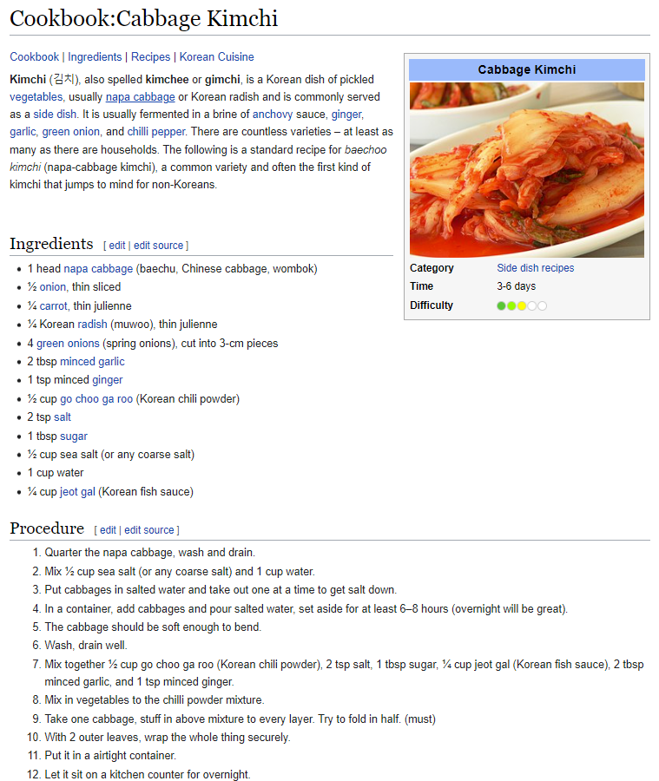
Notes:
in the case of a recipe, most have agreed on a single way: introduction, ingredients, and procedure, in that order, all written in the natural language of your choosing

Slide 14
Notes:
for computers, however, there is a significant divide in the CS community

Slide 15
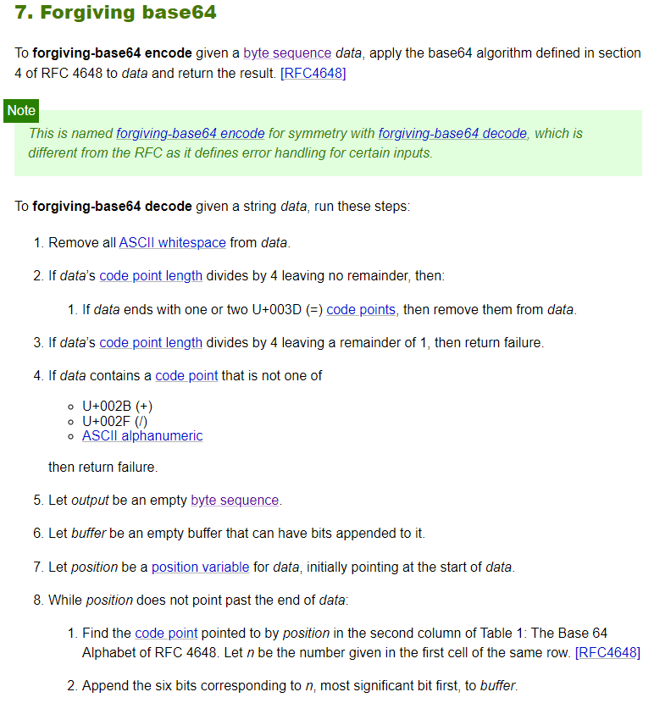
(van Kesteren and D. Denicola, 2006)
Notes:
natural language specifications are very similar to recipes: they use plain English with a dash of computer jargon to communicate the procedures of a program

Slide 16
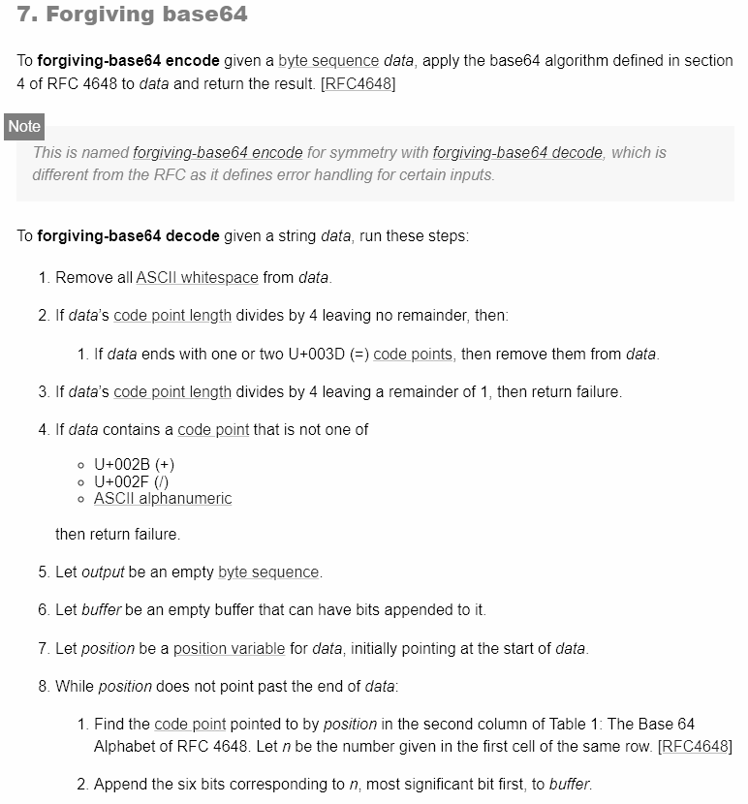
Notes:
however, due to the many intricacies of natural language, most computer scientists find natural language unsuitable for exhaustively and clearly communicating how a program ought to function

Slide 17

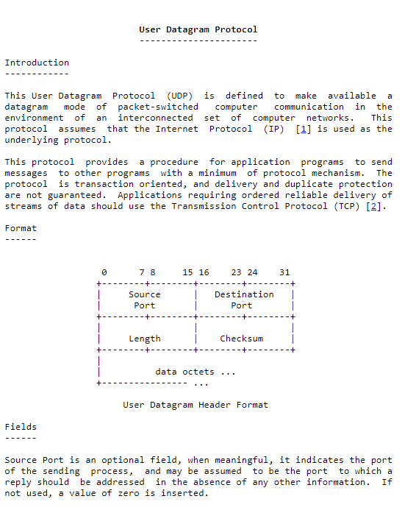
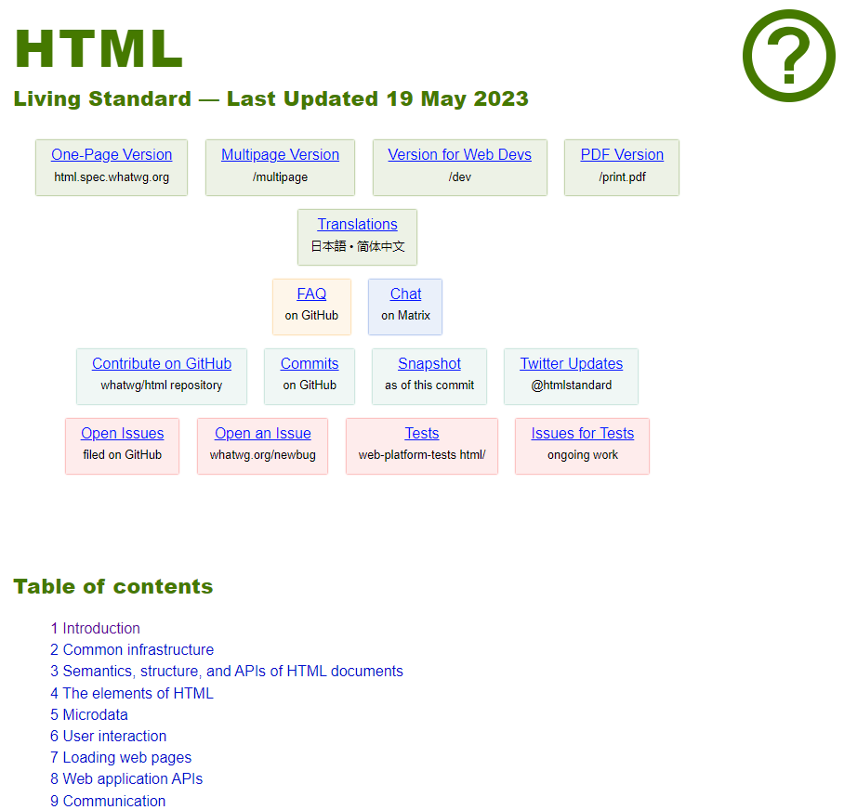
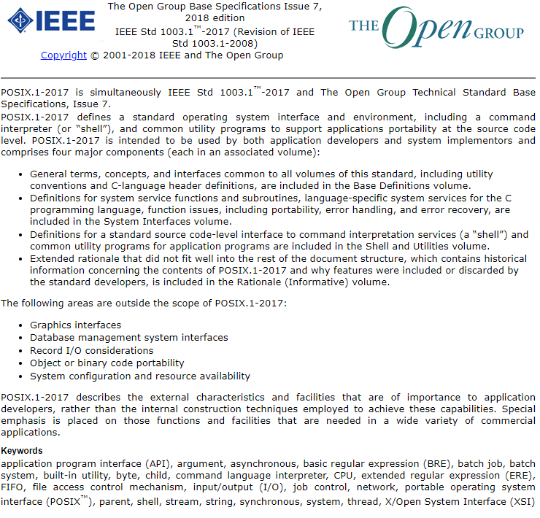
Notes:
this doesn’t stop natural language from being the primary way programmers communicate: the specifications for famous internet protocols like TCP and UDP, web browsers, and even entire operating systems like POSIX Unix are all described using natural language

Slide 18
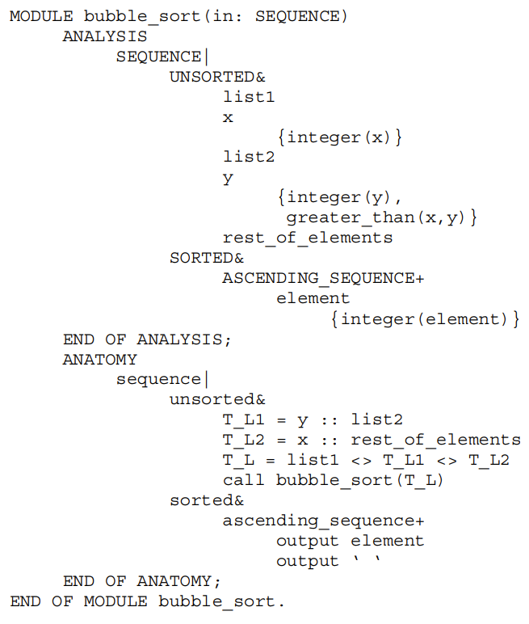
(Chiang, 2006)
Notes:
on the other hand, we have formal specifications; they’re written in precise notations inspired by discrete mathematics and programming languages that do exhaustively describe the functioning of a program

Slide 19
Notes:
formal specifications are extremely powerful but have seen limited adoption in the industry because of their complexity, significant barrier to entry, and incomprehensibility to non-programmers

Slide 20
[enters room]
“The use of natural language alone for specification purposes is inadequate due to its lack of formality.” (Chiang, 2006)
[drops citation]
[refuses to elaborate further]
[leaves]
Notes:
as you may guess, formal specifications are named as such because everyone presumes mathematical syntax is the only way to fully describe a program

Slide 21
Notes:
however, I believe that the benefits of formal specifications and natural language specifications can be married in such a way that we prevent our mission-critical software from having bugs at the conceptual level while not being exclusionary

Slide 22
Formalizing Natural-Language Specifications
How can natural language be formalized to make the process of writing specifications for complex software easier?
Kyle Williams — June 2nd, 2023
Notes:
this is the goal of my presentation: to explore a world where formal natural-language specifications exist

Slide 23
Notes:
so, let’s design one!

Slide 24
The Gorr Specification Language
by Kyle Williams
(get it? al-gor-ithm…? I’ll get my coat.)
Notes:
As part of my presentation, I have created a possible formal natural specification language named Gorr. Get it? Al-gor-ithm…? <silence> We will go through the specification together, highlighting my design decisions and how I have avoided the informal trappings of natural language.

Slide 25
Gorr
Python
The algorithm [[ factorial ]], with the signature integer [[ n ]] returns integer, does the following:
1. If either [[ n ]] is equal to 0 or [[ n ]] is equal to 1,
1.1. Return 1.
2. Otherwise,
2.1. Return the multiplication of [[ n ]] by call [[ factorial ]] arguments the subtraction of 1 from [[ n ]].
def factorial(n: int) -> int:
if n == 0 or n == 1:
return 1
else:
return n * factorial(n - 1)
Notes:
On the left, we have Gorr, my specification language, and on the right, an implementation of my specification in Python, one of the world’s most popular languages.

Slide 26
0! = 1
1! = 1
2! = 2 ✕ (2 - 1)! = 2 ✕ 1 = 2
3! = 3 ✕ (3 - 1)! = 3 ✕ 2 ✕ 1 = 6
n! = n ✕ (n - 1)!
Notes:
The topic of my specification is the factorial operator, a math operation which finds the product of a integer—you may call them whole numbers—and all integers less than it.
Mathematicians commonly define the factorial operator using itself, with 0 factorial and 1 factorial acting as base cases; this is a process known as recursion.
I will specify the factorial using the same method.

Slide 27
Gorr
Python
The algorithm [[ factorial ]], with the signature integer [[ n ]] returns integer, does the following:
1. If either [[ n ]] is equal to 0 or [[ n ]] is equal to 1,
1.1. Return 1.
2. Otherwise,
2.1. Return the multiplication of [[ n ]] by call [[ factorial ]] arguments the subtraction of 1 from [[ n ]].
def factorial(n: int) -> int:
if n == 0 or n == 1:
return 1
else:
return n * factorial(n - 1)
LEGEND:
algorithm name type signature
arguments return type
Notes:
My specification will have a single algorithm, the main building block of Gorr. They are used to encapsulate logic, in this case the process of calculating a factorial.
An algorithm is declared with a name and a type signature, which tell us how to use the algorithm. In this case, our algorithm “factorial” takes as an argument an integer n and returns an integer, just like the operator.

Slide 28
Gorr
Python
The algorithm [[ factorial ]], with the signature integer [[ n ]] returns integer, does the following:
1. If either [[ n ]] is equal to 0 or [[ n ]] is equal to 1,
1.1. Return 1.
2. Otherwise,
2.1. Return the multiplication of [[ n ]] by call [[ factorial ]] arguments the subtraction of 1 from [[ n ]].
def factorial(n: int) -> int:
if n == 0 or n == 1:
return 1
else:
return n * factorial(n - 1)
LEGEND:
body if statement otherwise statement
if block otherwise block condition
Notes:
After declaring the function, we then write its body, a list of numbered statements.
To implement the base and recursive cases, I use an if-otherwise statement to see if n is equal to either 0 or 1.
I do that check in the if statement’s condition; if the condition is true, the statements nested inside the if statement, known as a block, should be executed, otherwise, the otherwise block is executed.

Slide 29
Gorr
Python
In Gorr, if [[ n ]] is equal to 1:
either [[ n ]] is equal to 0 or[[ n ]] is equal to 1
evaluates to
either false or true,
which then evaluates to
true,
meaning the if block will be executed!
In Python, if n == 1:
n == 0 or n == 1
evaluates to
False or True,
which then evaluates to
True.
The algorithm [[ factorial ]], with the signature integer [[ n ]] returns integer, does the following:
1. If either [[ n ]] is equal to 0 or [[ n ]] is equal to 1,
1.1. Return 1.
2. Otherwise,
2.1. Return the multiplication of [[ n ]] by call [[ factorial ]] arguments the subtraction of 1 from [[ n ]].
def factorial(n: int) -> int:
if n == 0 or n == 1:
return 1
else:
return n * factorial(n - 1)
LEGEND:
body if statement otherwise statement
if block otherwise block condition
Notes:
Let’s zoom in on our if condition for a bit to see how we reach the base cases.
Our if condition contains two operators, the OR operator and the equivalence operator.
The equivalence operator takes two integers or two Booleans—think the on and off states of a light switch, but instead we use true and false—and sees if they’re the same value; if so, it evaluates to “true,” otherwise “false.”
The OR operator takes two Booleans and sees if either is true; if so, it evaluates to “true,” otherwise “false.”
Because Gorr evaluates operations from left to right, we first see if our integer “n” is zero and if “n” is one, and then see if either of those cases are true.
In the case where “n” is one, our if condition will evaluate to be true, meaning the if block is run.

Slide 30
Gorr
Python
Return the multiplication of [[ n ]] by call [[ factorial ]] arguments the subtraction of 1 from [[ n ]].
The algorithm [[ factorial ]], with the signature integer [[ n ]] returns integer, does the following:
1. If either [[ n ]] is equal to 0 or [[ n ]] is equal to 1,
1.1. Return 1.
2. Otherwise,
2.1. Return the multiplication of [[ n ]] by call [[ factorial ]] arguments the subtraction of 1 from [[ n ]].
def factorial(n: int) -> int:
if n == 0 or n == 1:
return 1
else:
return n * factorial(n - 1)
LEGEND:
body if statement otherwise statement
if block otherwise block condition
Notes:
Let’s also zoom in on the implementation of the recursive case.
Of note here is the return statement and our algorithm call.
The return statement stops execution of the algorithm and returns a value up to the place of the algorithm call.
In order to recurse, we call the “factorial” algorithm, passing the single argument “n - 1,” just like in the mathematical definition.

Slide 31
Gorr
Python
The algorithm [[ factorial ]], with the signature integer [[ n ]] returns integer, does the following:
1. If either [[ n ]] is equal to 0 or [[ n ]] is equal to 1,
1.1. Return 1.
2. Otherwise,
2.1. Return the multiplication of [[ n ]] by call [[ factorial ]] arguments the subtraction of 1 from [[ n ]].
def factorial(n: int) -> int:
if n == 0 or n == 1:
return 1
else:
return n * factorial(n - 1)
Notes:
And just like that, we have now specified an algorithm for calculating the factorial of an integer in a way that is easy to read.

Slide 32
The sentence
“Set [[ a ]] to true.”
can be parsed by the following rules:
⟨boolean⟩ → “true” | “false”;
⟨variable⟩ → “[[” ⟨space⟩? ⟨text⟩ ⟨space⟩? “]]”;
⟨variable assignment⟩ → “Set” ⟨space⟩ ⟨variable⟩ ⟨space⟩ “to” ⟨space⟩ ⟨boolean⟩ ⟨period⟩;
symbol
rule name
pattern
rule
Notes:
Gorr, like all languages, has a grammar; Its is written in Extended Backus-Naur Form, or EBNF, a grammar commonly used by computer scientists to specify the grammar of programming languages and protocols.
An EBNF grammar is a series of rules, each of them searching for a specified pattern of text.
For example, the pattern for a variable reference is two opening square brackets, an optional series of spaces, the name of your variable, another optional series of spaces, and two closing square brackets.

Slide 33
Notes:
There are two very important implications that come with Gorr being able to be represented in EBNF:

Slide 34
Natural Language Specification
Computer Representation
of Specification
“you misspelled a variable here”
“you can’t pass an integer as a boolean here”
“running your specification”
Notes:
Gorr can be parsed by a computer, which makes the automatic linting, verification, and even execution of a Gorr specification possible, among a litany of other ideas, and,

Slide 35
Natural Language Specification
It is impossible for the phrase
“either true or false”
to be parsed as
“either [[ true ]] or [[ false ]]”
because the grammar says so.
Computer Representation
of Specification
“you misspelled a variable here”
“you can’t pass an integer as a boolean here”
“running your specification”
Notes:
b. Any grammar written in EBNF is a formal grammar. The fact that Gorr has a fully defined structure almost entirely eliminates concerns about ambiguity. There is only one way to parse a Gorr specification. I will later show how this also helps with proving that there is only one way to interpret a Gorr specification.

Slide 36
Runthrough Complete!
Notes:
With that, our tour of Gorr is complete; for more information, a complete grammar of the language, and some example programs, see the informal description of the language I’ve handed out.

Slide 37
How My Approach Addresses Previous Issues with Natural Language
Notes:
Let’s now see how Gorr addresses the major issues the specification community has with natural language; I’ve name-dropped a few throughout explaining Gorr, but we’ll address them all at once here.

Slide 38
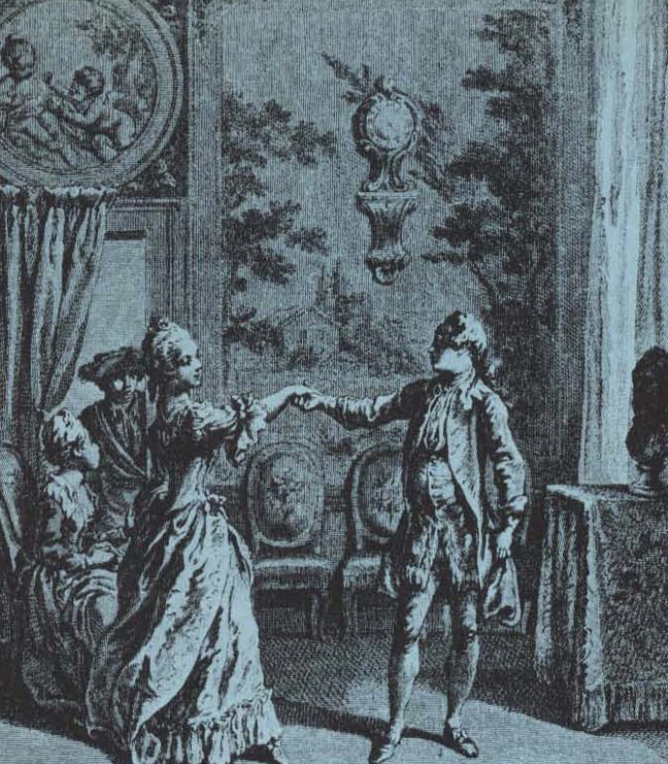
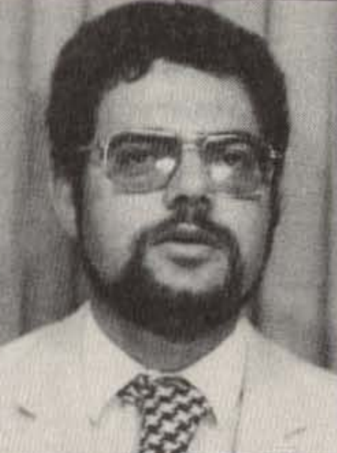
On Formalism and Specifications
Bertrand Meyer
IEEE Software, January 1985
Notes:
In his highly cited 1985 article “On Formalism and Specifications,” Bertrand Meyer argues against the use of natural language in formal specification, centering his argument around “the seven sins of the specifier.” We will look at all seven and see how Gorr addresses them.

Slide 39
Noise
The presence in the text of an element that does not carry information relevant to any feature of the problem.
Notes:
The first is noise: text that is irrelevant to describing the algorithm at hand.

Slide 40
Because Gorr is a subset of English limited by its grammar, Gorr can only describe the outline of an algorithm, nothing else.
Notes:
Gorr is a limited subset of the English language expressly designed for writing specifications. As such, a valid Gorr program can only describe the outline of an algorithm and nothing else. For example, in a Python program, it is impossible for one to go on and on about a problem in a way that is actually executed; this is because Python is a programming language, not a public forum.

Slide 41
Silence
The existence of a feature of the problem that is not covered by any element of the text.
Notes:
The second is silence, which is when a feature of a problem goes unspecified.

Slide 42
Gorr will not let you omit.
Notes:
Many of Gorr’s features prevent one from performing omission, including:
static typing,
variable initialization on declaration, and
variables and functions needing to be declared before they can be used

Slide 43
Over-specification
The presence in the text of an element that corresponds not to a feature of the problem but to features of a probable solution.
Notes:
The third is over-specification: specifying a solution to the problem instead of the problem itself.

Slide 44
Some may perceive Gorr as too algorithmic, but I believe that this approach to specification writing is valid.
Notes:
Gorr avoiding this sin is more of an opinion than an assertion. Many formal specification languages prefer a compositional approach, using sets and filters on those sets to narrow down toward a solution. Gorr instead uses an algorithmic approach, telling developers what their implementations must do in order to be valid; this approach will be more familiar to those already writing natural language specifications in the industry. I believe I soothe Meyer’s concerns a little by creating intentionally abstract definitions for data types, but he may believe that the algorithmic approach is itself an over-specification. I believe both are valid.

Slide 45
Contradiction
The presence in the text of two or more elements that define a feature of the system in an incompatible way.
Notes:
The fourth is contradiction, when two elements of a specification are at odds with one another.

Slide 46
Gorr’s strictly typed nature
prevents contradictions.
The following statements
The integer [[ meaning of life ]] is 42.
Set [[ meaning of life ]] to false.
are invalid in Gorr.
Notes:
The main example of contradiction Meyer brings up in the article is a specification changing the types of variables in the middle of a specification.
Because Gorr has only two types and is statically typed, meaning the type of a variable cannot be changed once it is declared, we avoid contradictions that arise from implicit transformations of data and the wishful thinking of “there must be a data structure that perfectly represents my problem, so I’ll just use it without explaining it.”

Slide 47
Ambiguity
The presence in the text of two or more elements that define a feature of the system in an incompatible way.
Notes:
The fifth is ambiguity: there are multiple ways to interpret a part of a specification.

Slide 48
The grammar and description
of the language come together.
Notes:
Gorr prevents ambiguity in two ways. The first is its grammar: there is only one way to parse Gorr. The second is its description: because Gorr redefines parts of the English language to match the context of a specification, Gorr gives the reader only one way to interpret what they have parsed. These two elements come together to create a near-bulletproof shield against ambiguity, with the only possible chinks being in the language’s description.

Slide 49
Forward References
The presence in the text of an element that uses features of the problem not defined until later in the text.
Notes:
The sixth is the forward reference, when something is referenced before it is defined.

Slide 50
The following statements
Set [[ meaning of life ]] to false.
The Boolean [[ meaning of life ]] is true.
are invalid in Gorr.
Notes:
Gorr prevents forward references by requiring variables and algorithms be declared before they can be used.
I will note that is possible to have forward references in many programming languages, which are universally believed to be formal, such as JavaScript; it doesn’t change the fact that forward references are confusing.

Slide 51
Wishful Thinking
The presence in the text of an element that defines a feature of the problem in such a way that a candidate solution cannot be realistically be validated with respect to this feature.
Notes:
Finally, we have wishful thinking: defining the problem in such a way that an implementation cannot be realistically verified.

Slide 52
You cannot escape the “sandbox”
of the Gorr language.
Notes:
Because one is limited to the constructs of the language when writing a Gorr specification, you can’t define behavior that cannot be accomplished with the specification language, meaning that implementation can still be verified.
I will note that this sin is the most weakly defined and that formal verification is very much not a solved problem in computer science; there are cases of implementations of valid specifications that cannot be trivially verified.

Slide 53
Why Natural Language?
This is cool and all, but, like,
Notes:
Alright! It seems like we’re really onto something here. As this presentation begins to wind down, I think it’s important to answer two questions, the first being “why natural language?”

Slide 54
It’s universal.
Notes:
I cling to natural language for the same reason everyone does: it’s universal.

Slide 55




Notes:
Anyone, with knowledge of the language a specification is written in and a little bit of training, can parse one for possible errors, including users, QAs, executives, designers, and anyone else who may lack deep computer science knowledge.

Slide 56

Notes:
We communicate in all other disciplines with natural language, so why should computers be the exception?

Slide 57

Notes:
Lowering the barrier to writing correct software is critical as technology more and more defines our world. I believe that controlled natural language can be a big help

Slide 58
If This Is Possible, Why Does Everyone Say It Isn’t?
Notes:
the second question that needs answering is, “well, if this is possible and it makes sense, how come a lot of people much smarter and more experienced than you say it isn’t?”

Slide 59
We need to find just the right amount.
Notes:
I think the issue is that people haven’t found the Goldilocks zone for the amount of freedom natural language gets in computer science yet.

Slide 60
repeat with i = 1 to the number of card fields
hide field i
end repeat
set dialogReply to display dialog "Dialog Text" ¬
default answer "Text Answer" ¬
hidden answer false ¬
buttons {"Skip", "Okay", "Cancel"} ¬
default button "Okay" ¬
cancel button "Skip" ¬
with title "Dialog Window Title" ¬
with icon note ¬
giving up after 15
SELECT *
FROM Book
WHERE price > 100.00
ORDER BY title;
Notes:
Programming languages like HyperCard, AppleScript, and SQL make use of natural language to represent computation in a form accessible to many. The issue is that these languages have limited domains; the natural language in a sense has too little freedom in order to express any arbitrary computation. One issue with AppleScript is that the syntax used for commands is usually defined by a third-party, meaning that in effect that AppleScript contains many small languages that all subtly clash with each other.

Slide 61
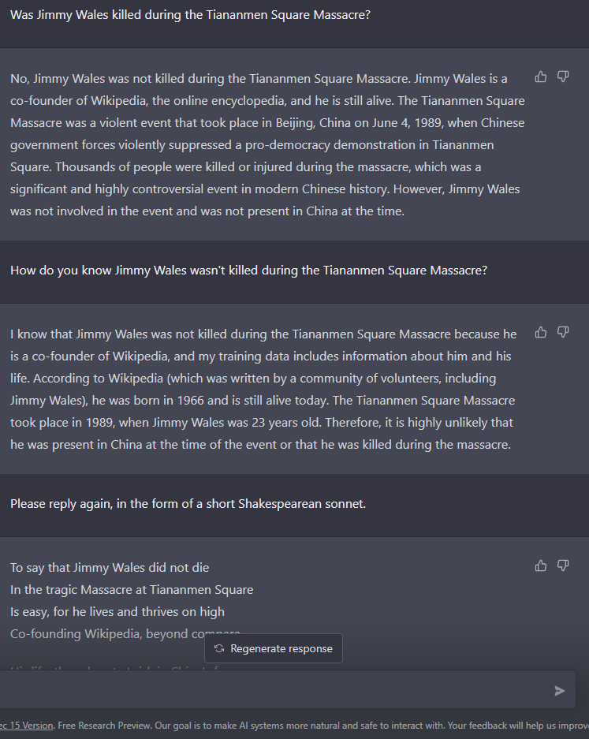

Notes:
On the other hand, there are people who want to derive computational meaning out of any utterance; this can be seen in tools like OpenAI’s GPT series of language models, which uses an amalgamation of text from the internet to generate convincing completions to questions, and the WolframAlpha answer engine, which uses a carefully built English parser to map words to symbols and concepts in the app’s database of facts.

Slide 62
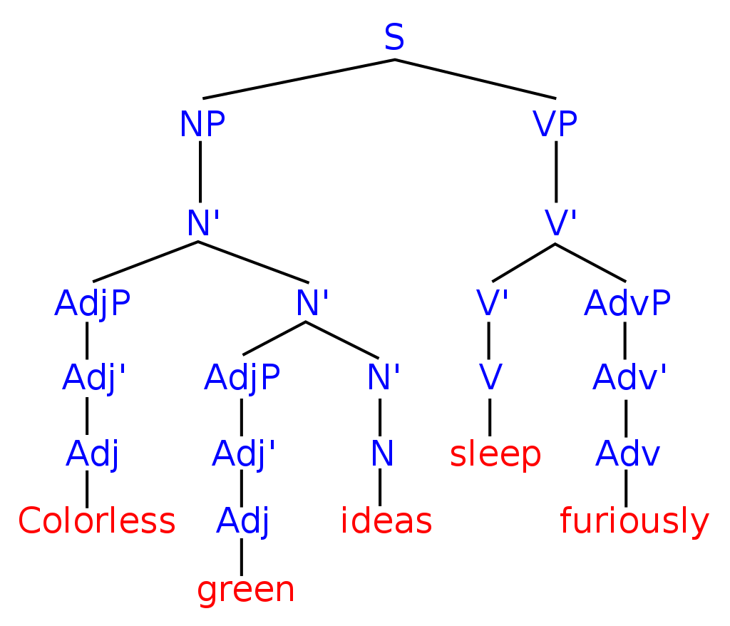
Notes:
Trying to extract meaning from any sentence is extremely difficult. While languages like English do have formal grammars, their grammars are large, and the process of then interpreting those parsed trees is another story entirely. Meyer’s seven sins don’t just describe why it’s hard to parse natural language specifications, but why it’s hard to parse almost natural language anything.

Slide 63
Notes:
I believe Gorr, with its context-free grammar and controlled-language-like restrictions strike a nice balance between the two. Hopefully, we’ll see proper languages that inherit the ideas of Gorr some day so that specification writing can be made that little bit easier.

Slide 64
</slideshow>
<!-- Thank you for listening! -->
Notes:
Thank you!

